Slide 1
PAWS
Positive Attitude Will Succeed
By Ed Peigneux

Slide 2
Objectives
Learn teaching tools.
Understand concept of “school climate.”
Discuss factors that affect behavior.
Notes:
2

Slide 3
Well-Managed Classroom
Sound theoretical foundation, understanding of classroom management
Strong, positive teacher-student and peer relationships
Instructional methods that motivate students
Maximize students “on-task” behaviors
Problem-solving and behavior management techniques – empower students for managing behavior
Notes:
3
SAY: “Please turn to workbook page _____ and read the goals and objectives for the workshop.”
ALLOW participants 2 minutes to read.
DO: Introduce yourself and review workshop guidelines. This includes discussing the materials the participants will use, scheduled breaks for lunch and using the restroom, where facilities (restrooms, vending machines, etc.) are located, and any other information the sites deems important. As participants are entering and getting settled, have them fill out the registration form, table tents, etc. Introduction of trainer needs to be kept brief.
REFER participants to overhead (Well Managed Classroom) and workbook page _____.
SAY: “ Welcome to the Well-Managed Classroom Workshop. A well managed classroom is a learning environment that fosters student involvement and cooperation in classroom activities that results in a positive and productive working environment. Thorough reviews of the research suggest that five major factors can be correlated with effective classroom management. Our primary focus will be on #5- developing good self-manager, and hopefully this will have an impact on #2-increase positive relationships and 4-maximize student “on-task” behaviors. When these correlates are in place, a positive climate is more likely to be developed in the building.”

Slide 4
Conflict Cycle
Incident Expands
Office Referral
Stress
Others’ Reactions
Cycle
3
Feelings & Anxieties
Behavior
Incident
Stress
Others’ Reactions
Cycle
2
Feelings & Anxieties
Event
Behavior
Stress
Others’ Reactions
Cycle
1
Feelings & Anxieties
Behavior
Notes:
4
REFER to the “Conflict Cycle” overhead and workbook page ____.
EXPLAIN: “Nicholas Long explains that the ‘conflict cycle’ begins when the student is stressed, and his or her thoughts and feelings drive the behaviors you see. These behaviors provoke reactions from others – the teacher, other students, the administrator, etc. The reactions of others to this student’s behaviors helps to determine whether the cycle continues or is broken. The way we choose to address these behaviors is critical in trying to contain or break the cycle. Let’s talk about some of the behaviors that students might display in each cycle.”
ASK: “What are some examples of behaviors that would be automatic office referrals?”
Trainer Note: Having participants identify behaviors that can earn students office referrals allows you to explain that there are some behaviors that should be dealt with one-on-one with the student in the office. Those behaviors would not be among the ones that will be discussed in the remainder to this section.
ALLOW the participants time to respond. Write some of their responses under “Office Referral.”
SAY: “In the first cycle, these are low level behaviors that cause disruption in the classroom, that you can’t ignore.”
ASK “What are some examples of behaviors that would be in Cycle 1?”
ALLOW the participants time to respond. Write some of their responses under “Cycle 1”.
TRAINER NOTE: Some possible responses may be: getting out of sit while teacher is talking, talking during instructional time, calling out answers, not paying attention by looking out window for extended period of time or messing with items in desk, etc.
SAY: “In cycle two, these could be the low level behaviors from Cycle 1 that continue over time.
Cycle 2 behaviors can also be higher level behaviors, that are in immediate need of your attention.”
ASK: “What are some examples of behaviors that you would identify in Cycle 2?”
ALLOW the participants time to respond. Write some of their responses under “Cycle 2.”
TRAINER NOTE: Some possible responses may be: Continued cycle 1 behaviors, students inappropriate responds to correction, slamming books, talking back, turning away from teacher, etc.
SAY: Cycle 3 is a result of continued inappropriate behaviors that have spiraled. As the spiral continues, the behavior is driven by emotion rather than a rational process. The cycle in which the student is functioning is a result of the frequency, intensity, and duration of the behavior.
ASK: “What are some of the examples of behaviors you would identify in “Cycle 3?”
ALLOW the participants time to respond. Write some of their responses under “Cycle 3.”
TRAINER NOTE: Some possible responses may be: continued Cycle 1 or 2 behaviors, destroying property, yelling at the teacher or another student, spitting, etc.
Trainer Note: The goal of this activity is to hear about some of the behaviors participants have to deal with in their classroom/building and to get a feel for the level of these behaviors. Another outcome is to determine how close a school’s staff members are to being able to identify behaviors in similar categories. For example, one teacher might have “talking out of turn” as a behavior in Cycle 1 while the rest of the school’s staff may have that behavior in Cycle 2. Also, talk with participants about tolerances and the importance of staff members having similar tolerances across the building. Discuss why tolerances might fluctuate and the importance of explaining those situations to students.
SAY: “The conflict cycle is not a step-by–step process. Some students may come into your classroom, already exhibiting cycle 2 or 3 behaviors. No matter what behaviors the student engages in, decreasing the likelihood that these behaviors occur involves having planned and purposeful strategies. These strategies cannot be limited to simply addressing these behaviors after they occur. These planned and purposeful strategies include setting clear expectations, building relationships, maintaining consistency, reinforcing positive behaviors, and correcting inappropriate behavior – before it escalates to the point that it did in the clip. Throughout this workshop we will give you systematic ways to address inappropriate behavior and encourage your students to develop and maintain responsible behaviors essential to their success – both inside and outside the classroom.”

Slide 5
A Positive Climate for Learning
Well Connected
Somewhat Connected
Society
Community
Neighborhood
Work
Not Connected
Family
Peers
School
Classroom
TEACHER
STUDENT
Notes:
5
Trainer Note: Prior to presenting the workshop, read The Ecology of Childhood: A Multi-System Perspective.
TRANSITION STATEMENT: “We tend to see the conflict cycle develop as Nicholas Long describes from students who are less connected to school and more connected to other factors that influence their lives.”
DO: Attach the chart, “A Positive Climate for Learning,” to the wall where everyone can see it.
Point to the top section of the chart.
SAY: “With the student that is well-connected, they have developed positive relationships with students and adults and consistently use skills that make them successful in the classroom academically and/or socially. They tend to be “looked up to” by the other students.
Point to the middle section of the chart.
SAY: “With the somewhat connected students, they have these skills, but may or may not consistently utilize them. These students tend to be followers. If it is ‘cool’ to be bad, these students can be swayed to follow those leaders.”
Point to the bottom section of the chart.
SAY: “The not connected students may have limited peer and adult relationships as a result of lacking some of the academic and/or social skills that allow them to feel more connected. They are less likely to become involved in extra-curricular activities. They can also be leaders in building; ‘I can’t do it and I’m not going to let anybody else do it’ attitude.”
Trainer Note: Connected students run the gamut from those “typically” connected like the head cheerleader, student council presidents, and football team captain to the “player” student, who knows they need to find a different way to be connected and become the class clown, charmer, etc. Elementary examples include smiles, volunteering to help, etc. that show they really like being in school.
SAY: “In buildings where the positive school climate is strong, you have more students who are well-connected. This does not just happen. The mission statement is purposeful and activities in the building build on the skills that should be developed to create this positive climate. In buildings where the climate is not as positive, the informal (or negative) mission begins to take over, i.e., “these kids can’t learn anything,” “don’t waste your time developing that plan,” etc.”
ACTIVITY: Self-Assessment of Classroom
DIRECT the participants to turn to page ___ in their Participant Workbooks.
SAY: “Think about the students in your class(es) now. What percentage of your students fit here (bottom of the wall chart)? Here (middle of the wall chart)? Here (top of the wall chart)? One of these areas represents the culture in your classroom. As we discuss strategies throughout the workshop, think about how you might use them in your classroom to move more students toward the bottom of the chart.”
ALLOW the participants time to respond.
ASK: “Which group is defining the culture in your classroom right now?”
Trainer Note: This is a rhetorical question.
EXPLAIN: “Ideally, you want the students in your class to be connected to school. (Refer to the top of the ‘Positive Climate’ chart.) You can accomplish this by creating a positive climate, ‘a place students want to be.’ You should set clear expectations, reinforce the good choices students make and address poor choices, and make the classroom a safe place where students can take both social and academic risks.
“When these students begin to move away from the classroom/school (refer to middle and bottom of the ‘Positive Climate’ chart), you begin to see them isolate themselves from the group and/or act out to get the attention of other students. As the adult, you may also tend to move away from those students and, therefore, cut off or change the relationship you have with the students who are toward the bottom of the chart. These students begin to seek attention in other ways and from other people in the school. They may even move toward the middle and bottom of the chart.
“If most of your students are in the middle or at the bottom of the chart, they may lack the motivation to change if you don’t make school a safe and encouraging place. If students continue here, you run the risk of losing them entirely.”

Slide 6
Traditional vs. Boys Town
Traditional Behavior Management
Boys Town Education Model
Views student as problem
Attempts to fix student
Attempts to extinguish behavior
Aversive approaches
Quick-fix
Focuses on environments, examples, skill deficits
Develop skills for student
Teaches replacement behaviors
Positive approaches
Ongoing process
Notes:
6

Slide 7
Preventing Problem Behaviors
Objectives
Discuss methods to proactively teach skills, procedures, schedules, consequences, and expectations.
Identify replacement skills to address problem behaviors in school/classroom.
Practice using Planned Teaching.
Notes:
7

Slide 8
Proactive Teaching
Proactively Teach Expectations
Rules
Procedures
Consequences
Skills

Slide 9
Proactive Teaching
Rules
Procedures
Consequences
Skills
Notes:
9
TRANSITION STATEMENT: “Although we often see ourselves as being proactive, we often tend to address rules, consequences, and specific classroom procedures at the beginning of the year or only when students make mistakes. We should make a specific plan to teach building and classroom rules, specific procedures, skills, and consequences throughout the school year.”
ASK: “What are some things that cause us to be more reactive than proactive?”
Possible responses might include: lack of time, the belief that students already know certain things, pressure to cover academic material, pressure to achieve and maintain test scores, etc.
REFER to “Proactive Teaching” overhead and workbook page ____.
Trainer Note: Refer back to the “A Positive Climate for Learning” chart.
EXPLAIN: “When the majority of students in our classrooms have outside influences that are greater than school (middle and lower part of chart), the teacher cannot simply state the rules, send home the student handbook, and teach their classroom procedures or skills once and expect students to engage in those behaviors. Even when the school is a major influence, students still need to have clear expectations. We need to create an environment that is predictable for our students. The more clear we can be about rules, procedures, skills, and consequences, the more likely students are to be successful. When developing rules, procedures, skills, and consequences, there are some general guidelines you should consider.
“Although your rules, schedules, and procedures may already be established, review them for the following points:
Class rules: concise, clear, posted, limited in number (three to five is an appropriate number), etc. Examples include bringing materials to class, following instructions, being on time to class, etc.
Schedules: daily schedules, changes due to assemblies, etc.
Procedures: clear, posted, simple to follow, etc. Examples include turning in papers, grading assignments, lunch count, etc.”
Skills: Behaviorally specific, etc. (Trainer Note: Refer back to guidelines for task analysis).
Consequences: clear, posted, and not just negative consequences.
SAY: “We just talked about several things to consider when developing skills. The most important things to remember are that skills should be behaviorally specific and that you should proactively teach students about consequences. Consequence should be clear and posted as a reminder to students.”
Trainer Note: Refer back to guidelines for task analysis.

Slide 10
Rules
Rules
Procedures
Consequences
Skills

Slide 11
Rules Should Be…
Stated behaviorally
Stated positively
Developmentally appropriate
Consistent with philosophy and function of the class
Within the parameters of school/district policies
Limited to three to five general behaviors
Prominently posted
Manageable and enforceable
Discussed and reviewed with students as needed
Adapted from Everton & Elmer, 1982

Slide 12
School Wide Rules
Be on time
Follow instructions
Respect others
Respect property of school and others
Do your best effort

Slide 13
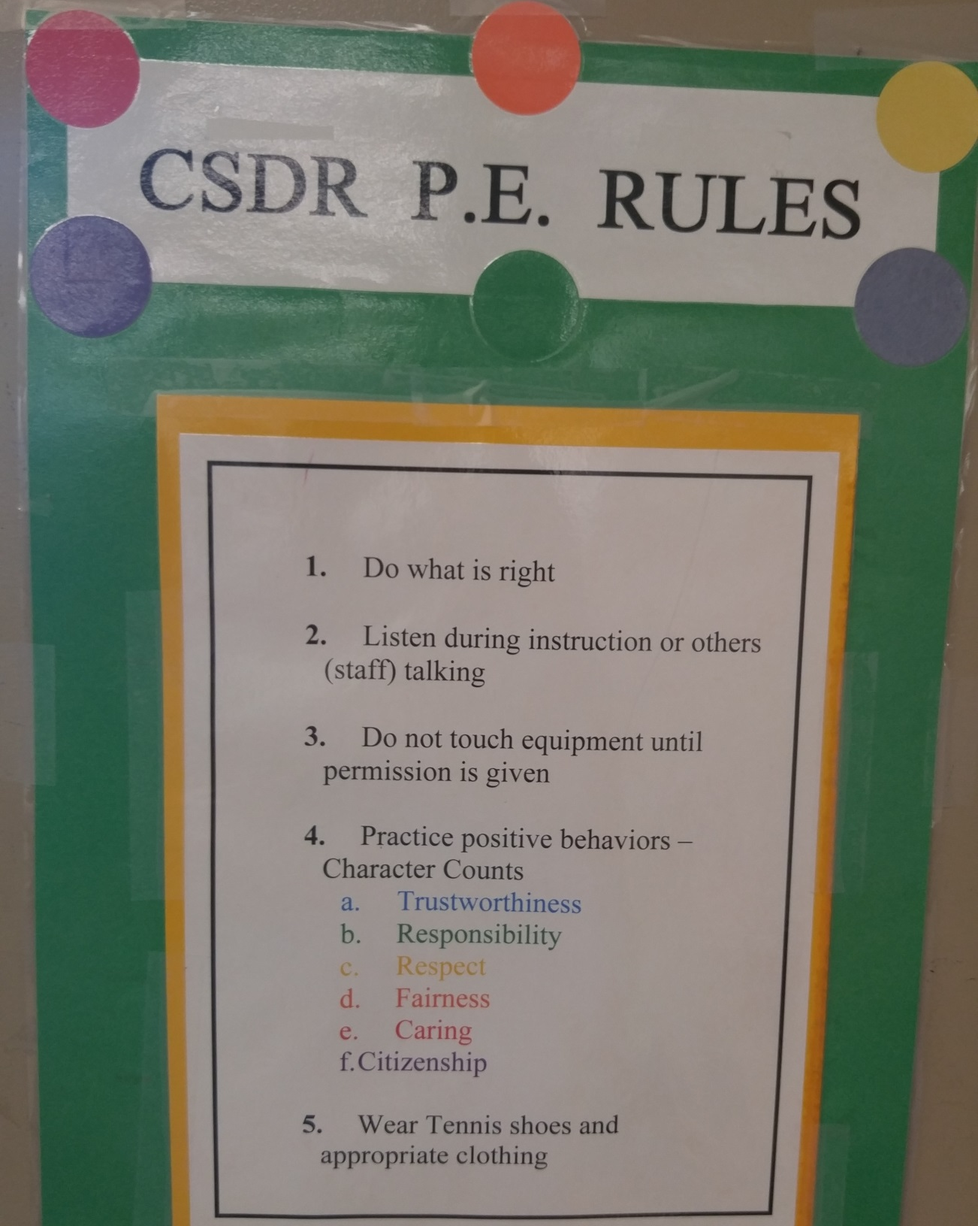

Slide 14
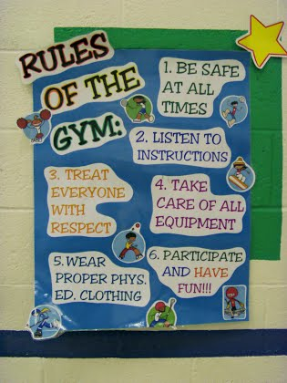

Slide 15
Procedures
Proactively Teach Expectations
Rules
Procedures
Consequences
Skills

Slide 16
Guidelines for Establishing Procedures
Decide what you want to accomplish
Determine behaviors needed
Identify steps
Post when deemed necessary
Teach and review
Adapted from Everton & Elmer, 1982
Notes:
16
TRANSITION STATEMENT: “Many of our rules, procedures, and consequences serve to control the behavior of students instead of empowering them to make responsible decisions. Although we need a certain number of compliance-based rules or skills to ensure smooth classroom operation, we can achieve the greatest good by helping students learn to make responsible choices about their own behavior. Doing so provides them with the tools for meeting future challenges, in addition to helping them succeed in school.”

Slide 17
How to Get My Attention in Class
Raise your hand!
I love to answer questions – please don’t hesitate to ask a question.
I will happily answer questions from students who are patiently waiting with their hand raised.
Good Example / Bad Example

Slide 18
Locker Procedure
Please be responsible!
We will not leave during class for items left in lockers – please think ahead!
In the morning before entering the room please get supplies for the day

Slide 19
Classroom Procedures
Give me FIVE!
Talking in class
Moving around the room
How to get my attention
Leaving the room during class
Lockers
Classroom Library
Student Agenda
Water bottles
End of the day
Student Assignments
Extra help
Classroom Jobs
Reward Tickets
Classroom Compliments

Slide 20
Emergency Procedures
Earthquake
Fire
Lockdown

Slide 21
Consequence
Rules
Procedures
Consequences
Skills

Slide 22
Effective Consequence
Appropriateness
Immediacy
Amount or size
Contingency

Slide 23
Positive Consequences
Praise/Gestures
Free time
Computer time
Tangible Rewards
Positive notes or comments to parents
Teacher helpers
Reduction in assignments
Call Home
Reward Day
Classroom seating chart
Alternative assignment or shorten assignment
Pat on the back
Verbal reinforcement
Fun Time
Leisure reading time

Slide 24
Negative Consequences
Seating chart
Referral
Detention
Parent conference
Call own parents
Time-out
Verbal warning
Loss of privileges
Move card from green to yellow or red
In-hall counseling
Lunch detention
Exclusion from extra activities

Slide 25
Social Skills
Rules
Procedures
Consequences
Skills

Slide 26
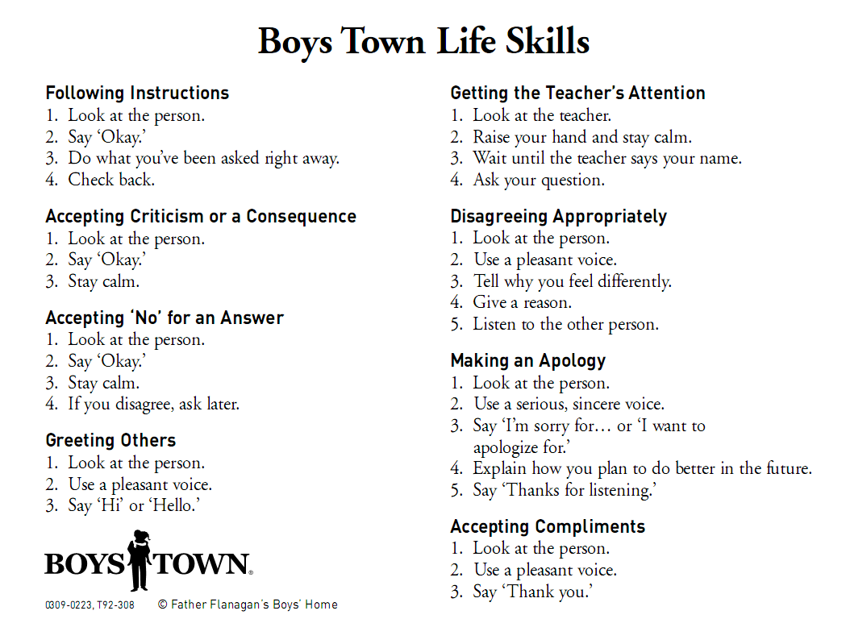
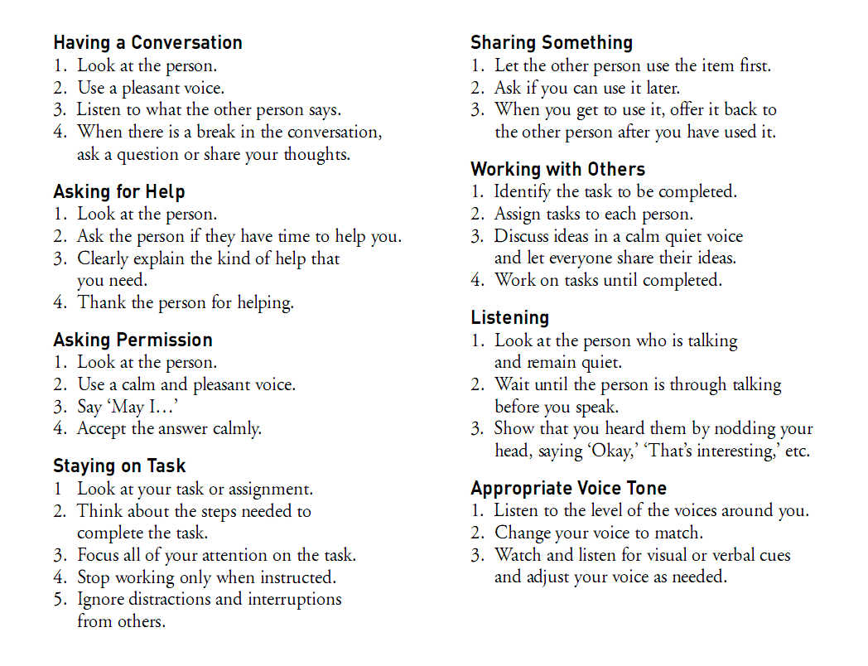
Boys Town Social (Life) Skills
Copyright © 2007 by Father Flanagan’s Boys’ Home
Notes:
26

Slide 27
Proactive Teaching
Teaching expectations for future behaviors
Planned Teaching
Preventive Prompts
Blended Teaching
* Teach at a neutral time
Notes:
27
REFER to the “Proactive Teaching” overhead (13) and workbook page ____.
SAY: “You already do a lot of Proactive Teaching around the rules, procedures, and consequences in your classrooms. We will talk more about making decisions on consequences as they apply to each of the interactions we will discuss and practice.”
TRANSITION STATEMENT: “Proactive Teaching probably is used least often in the area of skill teaching. Let’s take a step back and look at some ways we can proactively address some common problems that occur in our classrooms. The Girls and Boys Town Education Model has three techniques for proactively teaching skills. They are Planned Teaching, Preventive Prompts, and Blended Teaching.”

Slide 28
Planned Teaching
Introduce the skill
“Hook” (anticipatory set)
Describe appropriate behavior
Label the skill
Describe the skill steps
Give a reason
Meaningful to the student
Brief
Practice
Set up clearly
Have student practice to criteria
Ask questions related to the skill

Slide 29
Types of Reasons
Avoid Negative Outcome
Benefit to Self
Concern for Others
Notes:
29

Slide 30
Planned Teaching – Middle/High School Example
Introduce the skill
“When was the last time you had a disagreement with someone?”
Describe appropriate behavior
“When you disagree, remember to look at the person, use a pleasant voice, tell why you feel differently, give a reason, then listen to the other person.”
Give a reason
“That way, people are more likely to listen to your side of the story.”
Practice
“Let’s practice disagreeing appropriately now to prepare for tomorrow’s debate.”

Slide 31
Average Retention Rate
Amount of information that goes into long-term memory by how it’s processed.
Passive
Lecture
5%
Reading
10%
Audio-Visual
20%
Demonstration
30%
Discussion
50%
Practice By Doing
75%
Active
Teaching It
90%
0
100
Adapted from the National Training Lab - Bethesda, Maryland
Notes:
31

Slide 32
Alternative Plan
A procedure for students to use, when you are:
Otherwise engaged
Unavailable
Addressing on-going behavior
Notes:
From SCM

Slide 33
Alternative Plan - Example
Skill Name: “Give me five”
Steps:
Face forward
Ignore distractions
Voices off
Eyes on your work
Reason(s): Keeps students out of trouble
Ideas for Practice: Role-play (teacher as distraction)
Prompt: Holding up hand with five fingers
Notes:
From SCM

Slide 34
Preventive Prompts
Brief reminder to students before they…
Use a skill
Use a rule
Follow a procedure
Notes:
34
ASK: “When are some times when using a Preventive Prompt would be beneficial?”
ALLOW the participants time to respond.
Trainer Note: Be sure to stress the importance of using Preventive Prompts prior to when students are expected to follow rules or procedures in class as well as when students are going to use a skill.
SAY: “Return to your lesson plan and develop a Preventive Prompt for your skill. Identify some specific times when you would use the prompt.”
ALLOW the participants _____ minutes to develop a Preventive Prompt.
ASK: “What are some specific times when you could use a prompt?”
ALLOW the participants time to respond.

Slide 35
Proactive Teaching
Teaching expectations for future behaviors
Planned Teaching
Preventive Prompts
Blended Teaching
* Teach at a neutral time
Notes:
35
REFER to the “Proactive Teaching” overhead (13) and workbook page ____.
SAY: “You already do a lot of Proactive Teaching around the rules, procedures, and consequences in your classrooms. We will talk more about making decisions on consequences as they apply to each of the interactions we will discuss and practice.”
TRANSITION STATEMENT: “Proactive Teaching probably is used least often in the area of skill teaching. Let’s take a step back and look at some ways we can proactively address some common problems that occur in our classrooms. The Girls and Boys Town Education Model has three techniques for proactively teaching skills. They are Planned Teaching, Preventive Prompts, and Blended Teaching.”

